Slide 1
Celebes Stress Inversion

Slide 2
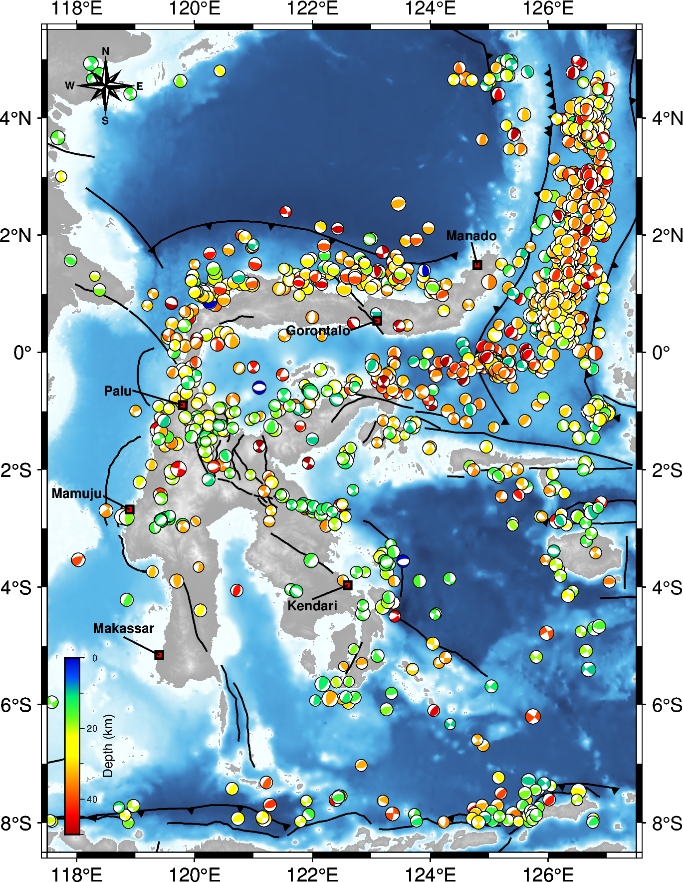
Focal Mechanism Data
1390 data mekanisme fokal
1967 - 2022
kedalaman < 50km
magnitude 4.0 < Mw < 7.0.

Slide 3
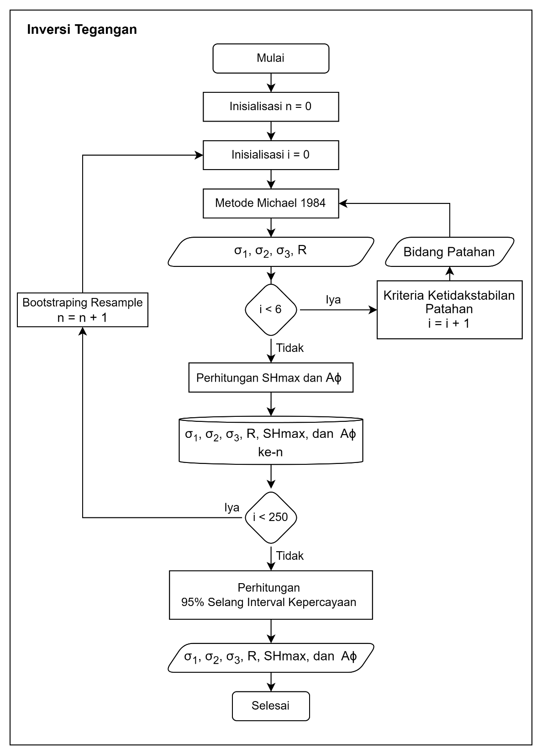
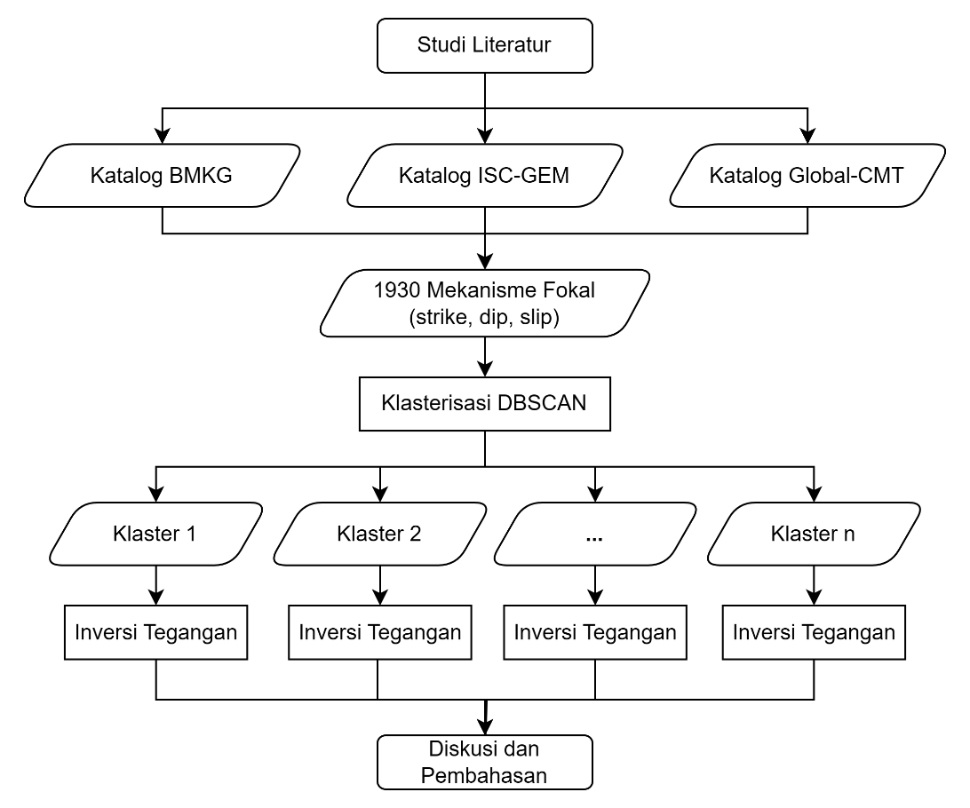
Metode Penelitian
Proses inversi tegasan dilakukan menggunakan modifikasi program STRESSINVERSE (Vavrycuk, 2014) dengan menambahkan perhitungan SHmax dan Simpson’s Index.
Ketidak pastina pengukuran dihitung menggunakan metode bootstrap resample dengan 250 sampel.

Slide 4
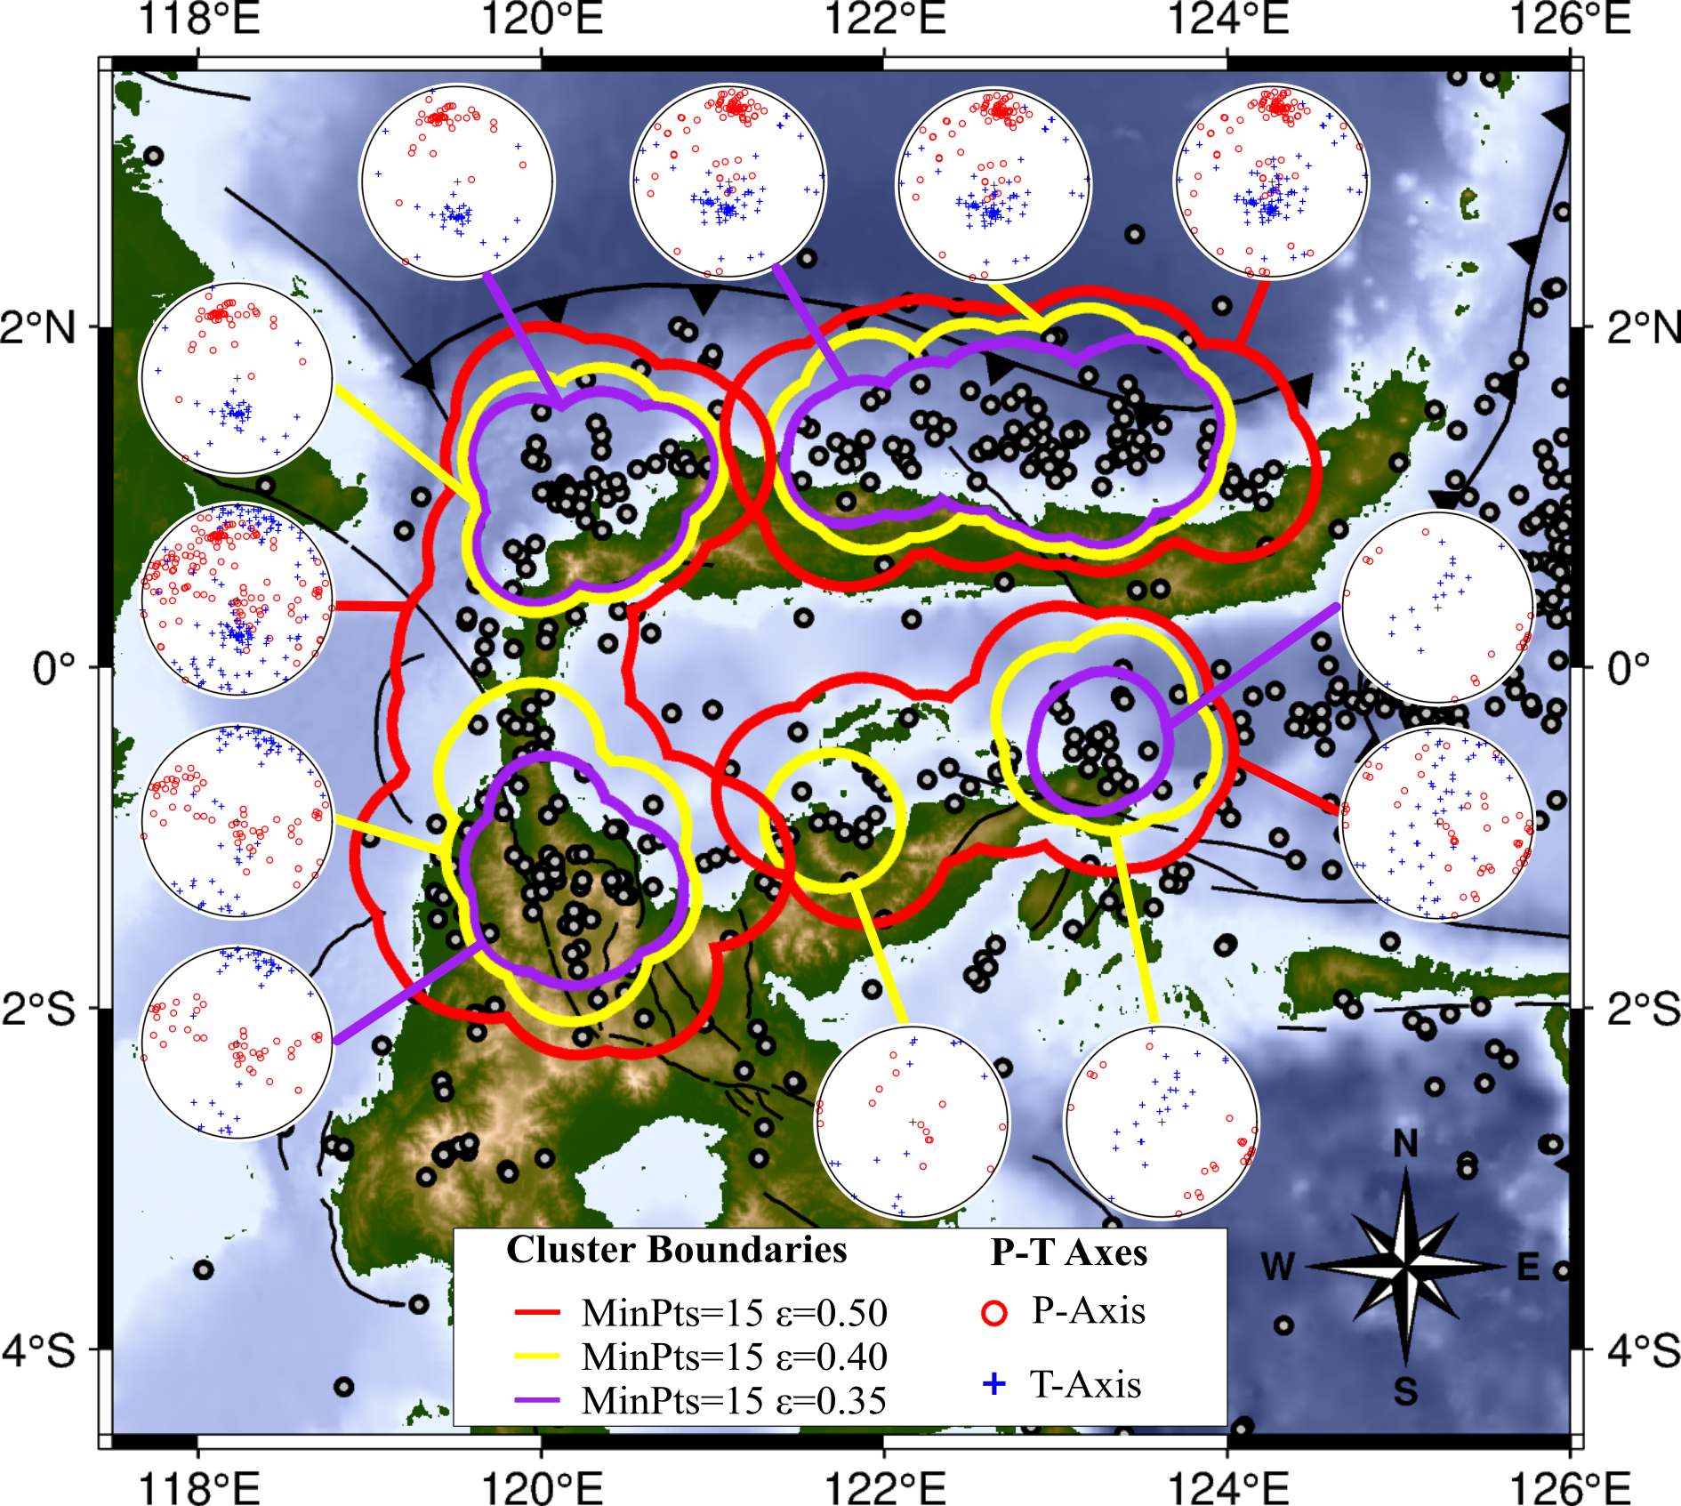
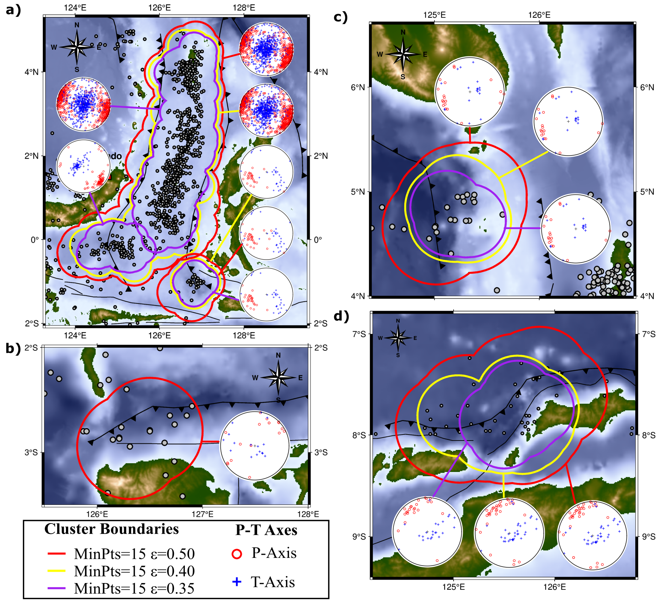
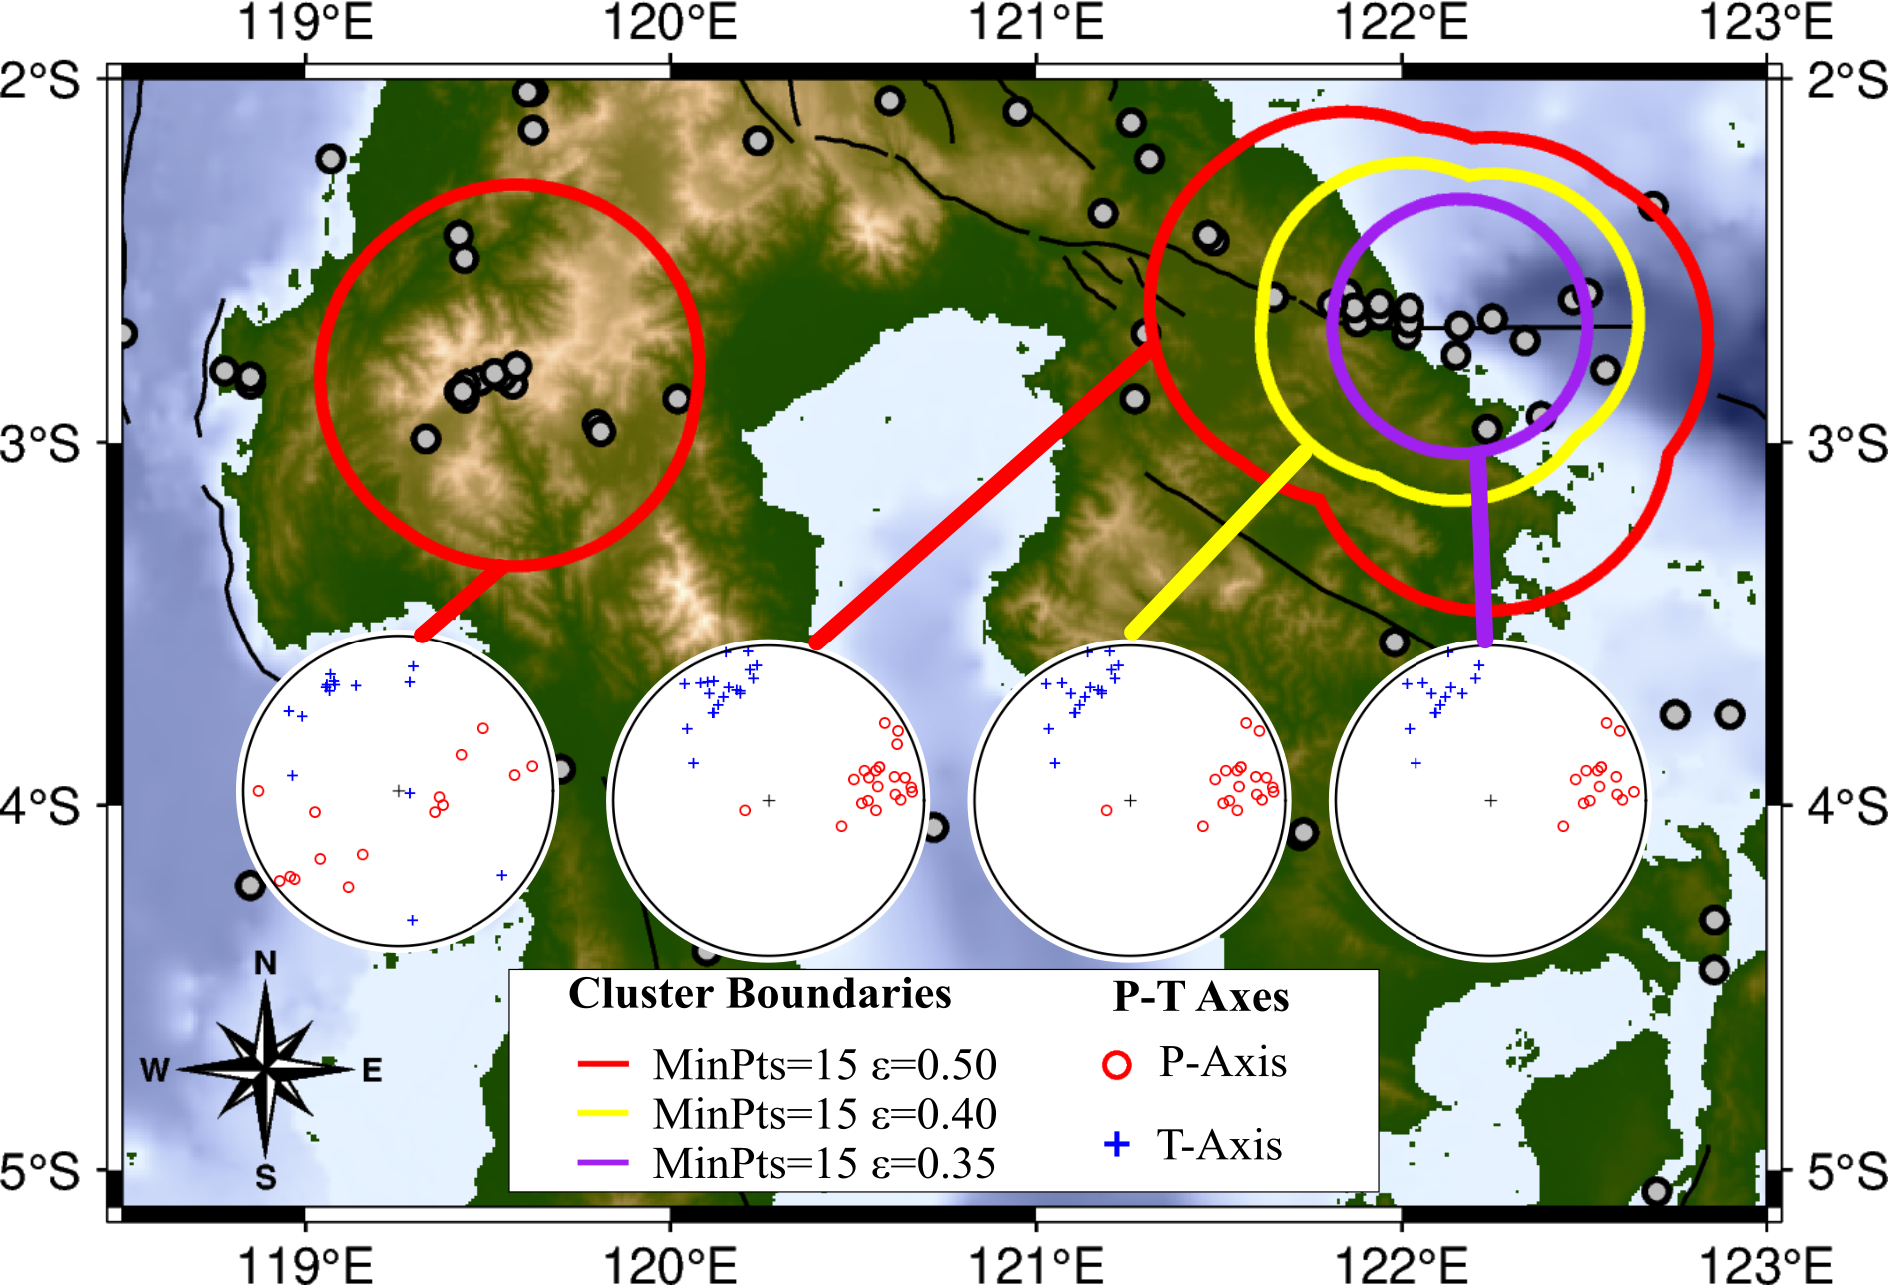
$$Hasil Klasterisasi$$
Sulawesi Bagian Utara
Sulawesi Bagian Selatan
Area Sekitar
Hasil dari proses klasterisasi DBSCAN memberikan 30 klaster dengan menggukan parameter epsilon 0.35, 0.40, dan 0.50 dengan minimum point 15

Slide 5
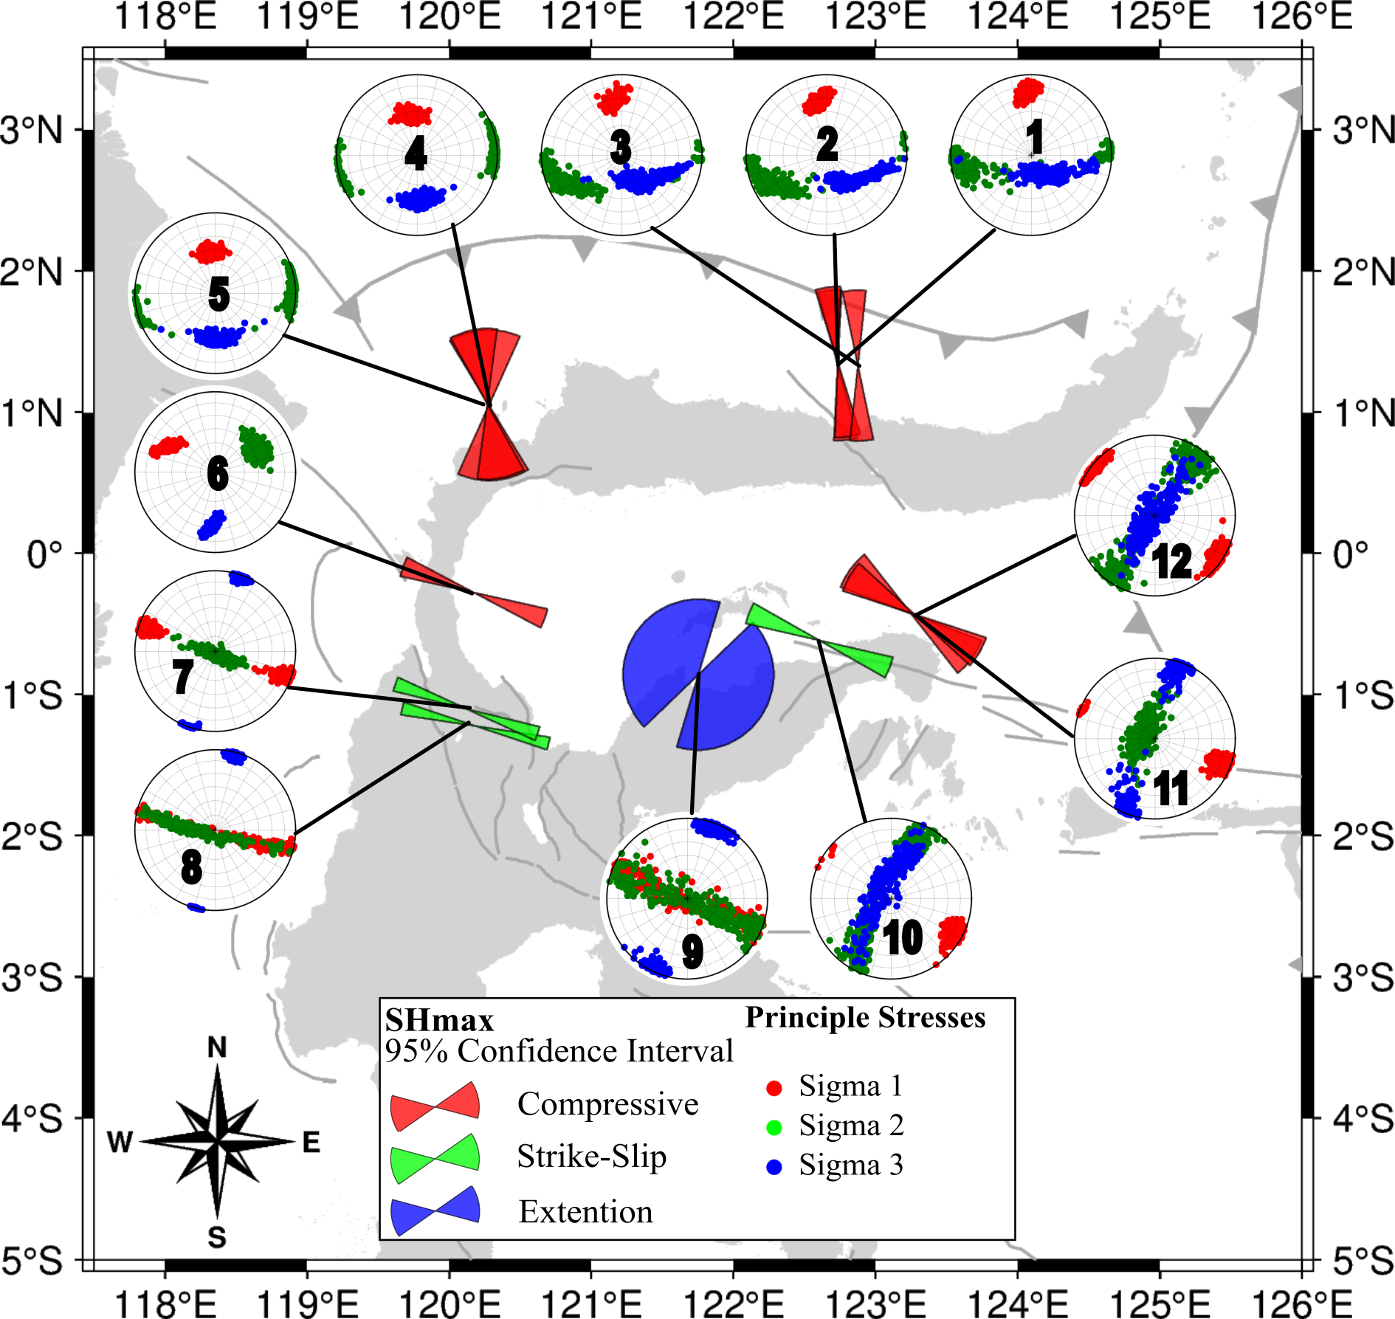
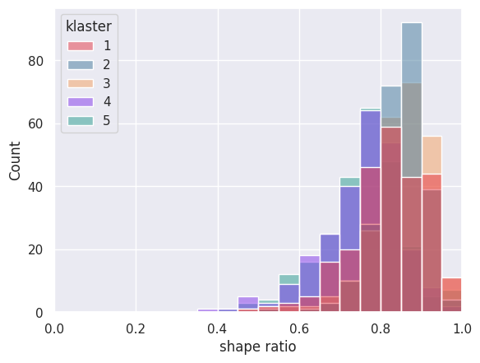
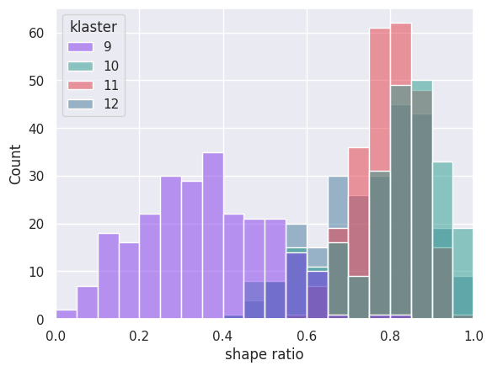
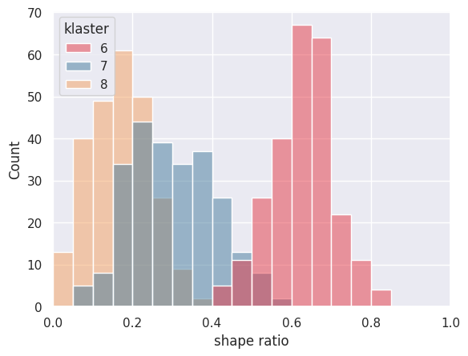
$$Hasil Inversi Tegasan$$
Sulawesi Bagian Utara

Slide 6
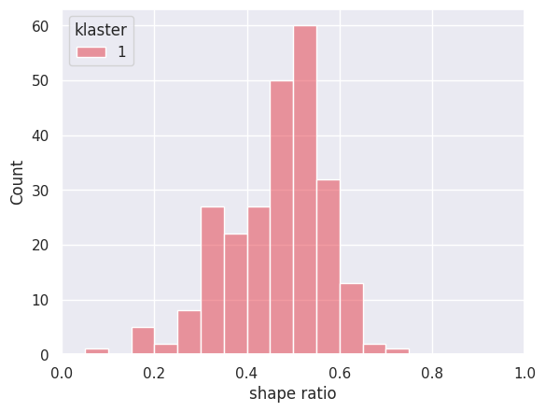
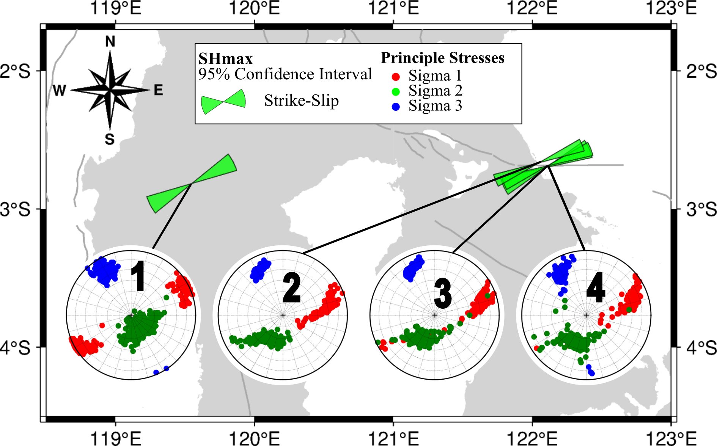
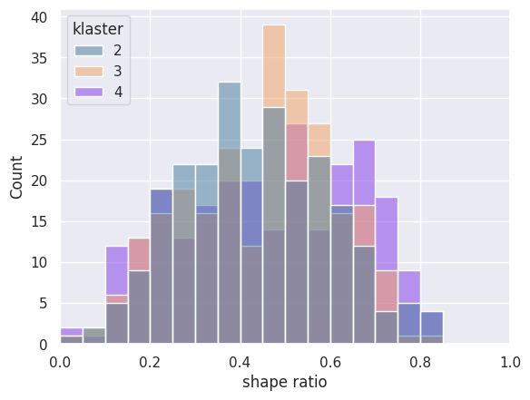
$$Hasil Inversi Tegasan$$
Sulawesi Bagian Selatan

Slide 7
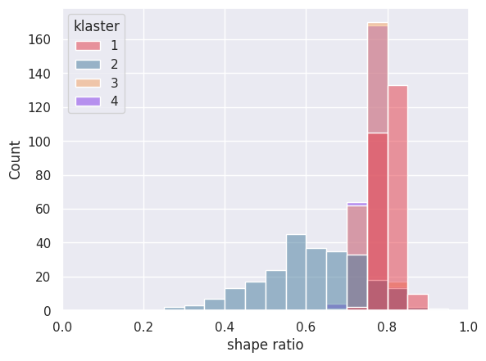
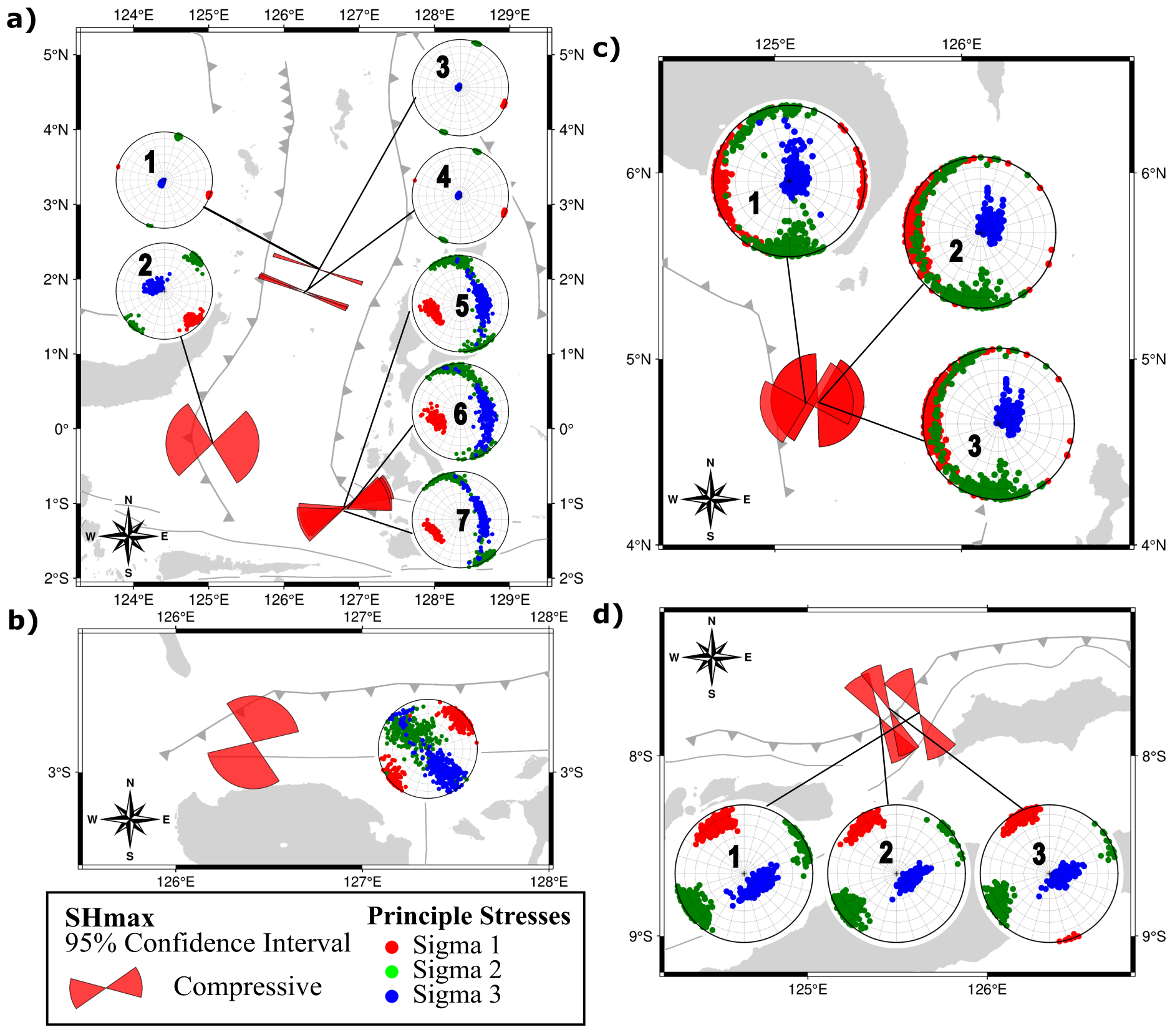
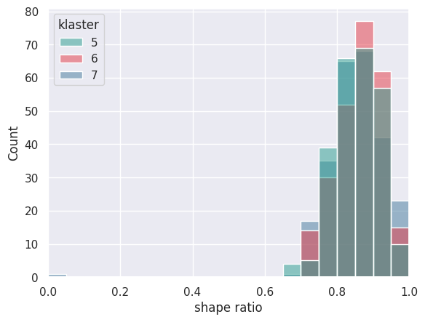
$$Hasil Inversi Tegasan$$
Wilayah Laut Maluku

Slide 8
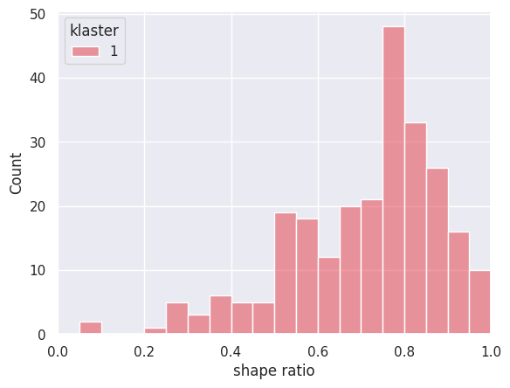
$$Hasil Inversi Tegasan$$
Wilayah Sula

Slide 9
$$Hasil Inversi Tegasan$$
Wilayah Sangihe Barat

Slide 10
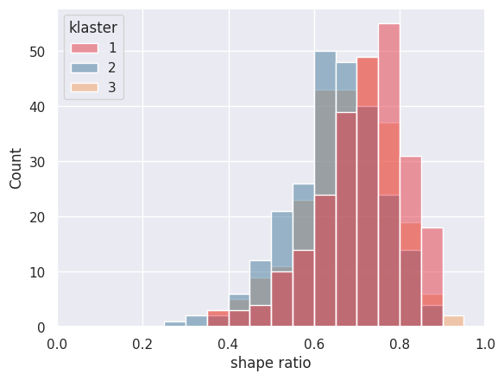
$$Hasil Inversi Tegasan$$
Wilayah Laut Maluku

Slide 11
$$Tabel Hasil Inversi Tegasan$$
Klaster | Sigma 1 (˚) azimuth/plunge | Sigma 2 (˚) azimuth/plunge | Sigma 3 (˚) azimuth/plunge | R | SHmax | Aφ
Sulawesi Bagian Utara
1 | 356/22 ± 09/11 | 255/29 ± 20/28 | 156/51 ± 58/27 | 0.786 ± 0.181 | 357 ± 09 | 2.13
2 | 350/32 ± 11/10 | 241/23 ± 26/22 | 137/44 ± 37/22 | 0.826 ± 0.120 | 352 ± 10 | 2.14
3 | 352/30 ± 11/11 | 245/23 ± 28/22 | 142/46 ± 42/24 | 0.795 ± 0.160 | 354 ± 09 | 2.14
4 | 351/47 ± 16/08 | 083/05 ± 19/05 | 174/43 ± 22/08 | 0.705 ± 0.210 | 356 ± 28 | 2.23
5 | 353/47 ± 14/08 | 265/07 ± 19/06 | 178/43 ± 22/07 | 0.745 ± 0.205 | 349 ± 18 | 2.23
6 | 299/32 ± 10/11 | 059/41 ± 18/11 | 183/33 ± 07/10 | 0.617 ± 0.163 | 290 ± 08 | 2.37
7 | 289/15 ± 06/15 | 121/74 ± 73/14 | 019/04 ± 05/04 | 0.308 ± 0.203 | 289 ± 06 | 1.72
8 | 288/40 ± 09/38 | 106/47 ± 52/36 | 013/05 ± 05/05 | 0.177 ± 0.138 | 284 ± 05 | 1.89
9 | 289/43 ± 50/41 | 123/44 ± 50/41 | 204/08 ± 15/08 | 0.365 ± 0.275 | 301 ± 75 | 0.98
10 | 120/13 ± 11/12 | 206/35 ± 28/32 | 357/49 ± 74/33 | 0.731 ± 0.235 | 120 ± 12 | 2.10
11 | 111/14 ± 08/13 | 283/64 ± 84/20 | 024/22 ± 14/22 | 0.788 ± 0.146 | 111 ± 08 | 1.17
12 | 306/09 ± 15/09 | 215/29 ± 19/28 | 040/60 ± 70/27 | 0.744 ± 0.212 | 306 ± 16 | 2.14

Slide 12
$$Tabel Hasil Inversi Tegasan$$
Klaster | Sigma 1 (˚) azimuth/plunge | Sigma 2 (˚) azimuth/plunge | Sigma 3 (˚) azimuth/plunge | R | SHmax | Aφ
Sulawesi Bagian Selatan
1 | 243/14 ± 15/14 | 146/67 ± 62/15 | 329/18 ± 10/15 | 0.433 ± 0.193 | 242 ± 11 | 1.56
2 | 081/37 ± 17/22 | 211/44 ± 25/18 | 333/23 ± 09/07 | 0.451 ± 0.309 | 068 ± 08 | 1.57
3 | 074/26 ± 13/18 | 204/53 ± 36/13 | 335/21 ± 09/07 | 0.423 ± 0.296 | 068 ± 09 | 1.55
4 | 072/29 ± 15/21 | 194/47 ± 41/15 | 330/24 ± 10/11 | 0.550 ± 0.316 | 066 ± 11 | 1.46
Wilayah Maluku Utara
1 | 108/03 ± 02/02 | 018/05 ± 02/04 | 230/84 ± 28/04 | 0.809 ± 0.046 | 108 ± 02 | 2.20
2 | 135/17 ± 09/10 | 044/09 ± 10/09 | 300/70 ± 37/11 | 0.603 ± 0.234 | 097 ± 51 | 2.37
3 | 111/04 ± 03/02 | 021/02 ± 03/02 | 291/86 ± 51/02 | 0.765 ± 0.046 | 111 ± 03 | 2.24
4 | 110/03 ± 03/02 | 200/02 ± 03/02 | 291/86 ± 51/02 | 0.759 ± 0.047 | 110 ± 03 | 2.23
5 | 249/38 ± 21/11 | 347/20 ± 30/20 | 082/45 ± 59/15 | 0.857 ± 0.120 | 253 ± 22 | 2.14
6 | 251/44 ± 20/12 | 000/18 ± 44/18 | 095/34 ± 56/20 | 0.854 ± 0.116 | 249 ± 23 | 2.12
7 | 244/37 ± 17/07 | 346/25 ± 35/25 | 072/39 ± 65/16 | 0.852 ± 0.116 | 245 ± 16 | 2.11

Slide 13
$$Tabel Hasil Inversi Tegasan$$
Klaster | Sigma 1 (˚) azimuth/plunge | Sigma 2 (˚) azimuth/plunge | Sigma 3 (˚) azimuth/plunge | R | SHmax | Aφ
Wilayah Sula
1 | 047/16 ± 24/15 | 305/42 ± 69/36 | 149/41 ± 39/38 | 0.621 ± 0.339 | 021 ± 55 | 2.17
Wilayah Sangihe Barat
1 | 256/08 ± 42/08 | 166/23 ± 41/23 | 018/66 ± 81/22 | 0.526 ± 0.355 | 254 ± 43 | 2.41
2 | 282/11 ± 73/10 | 193/16 ± 73/15 | 051/70 ± 55/16 | 0.442 ± 0.333 | 284 ± 74 | 2.68
3 | 282/11 ± 73/10 | 193/16 ± 73/15 | 051/70 ± 55/16 | 0.442 ± 0.333 | 284 ± 74 | 2.68
Wilayah Nusa Tenggara Timur
1 | 329/18 ± 19/11 | 238/15 ± 20/14 | 136/66 ± 55/11 | 0.672 ± 0.203 | 330 ± 20 | 2.25
2 | 326/14 ± 16/09 | 233/15 ± 17/15 | 122/67 ± 44/13 | 0.618 ± 0.211 | 328 ± 18 | 2.34
3 | 333/09 ± 14/09 | 242/16 ± 15/15 | 101/70 ± 49/13 | 0.649 ± 0.210 | 335 ± 14 | 2.27

